Slide 1
STUDENT DB MANAGEMENT SYSTEM
BY
S.V.Ilavendhan

Slide 2

ABSTRACT
Student Record Management System contains data and information of Student
The Main Purpose of SRMS is to Systematically record, store and update the Student records
Progressions can be brought about in the overall system of education, when the concept of Student management is identified in as appropriate manner

Slide 3

INTRODUCTION
The Student Management System (SMS) is a comprehensive digital solution designed to streamline the administration of educational institutions.
In The Student Management System we use python and MYSQL database. This is the project which keeps records of Student.

Slide 4
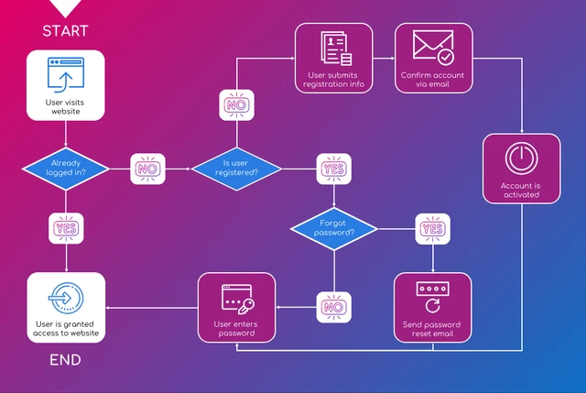
LOGIN PAGE FLOW CHART

Slide 5
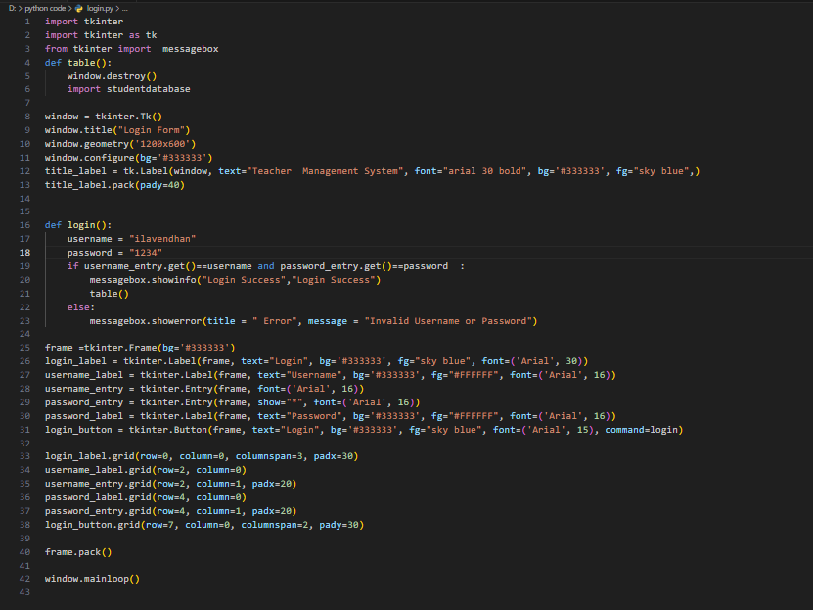
LOGIN CODE

Slide 6
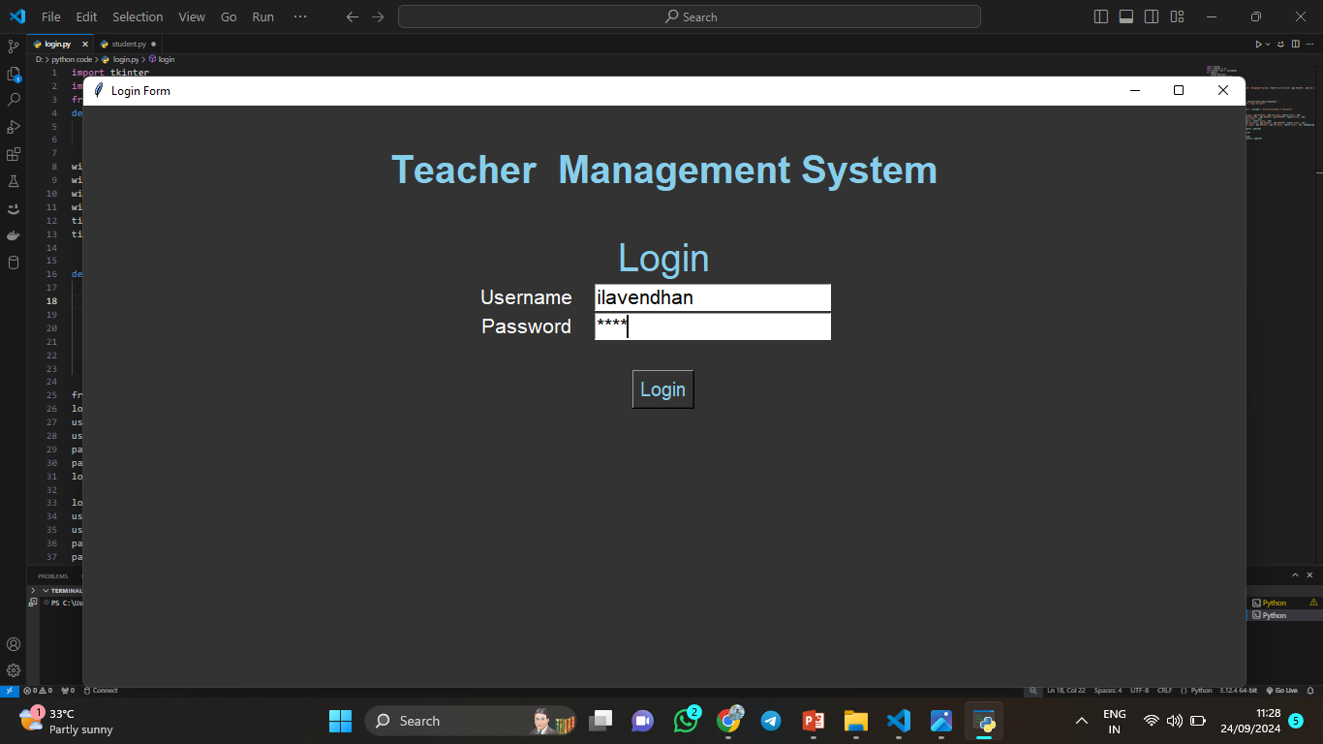
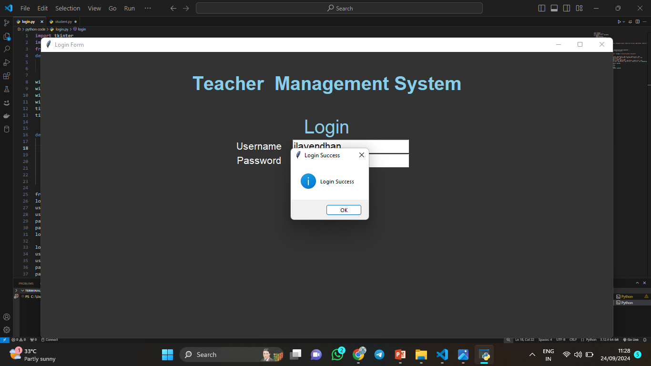
Login Output

Slide 7
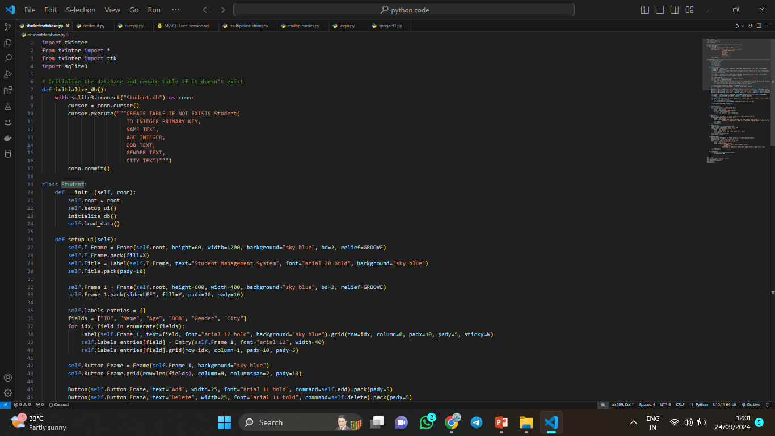
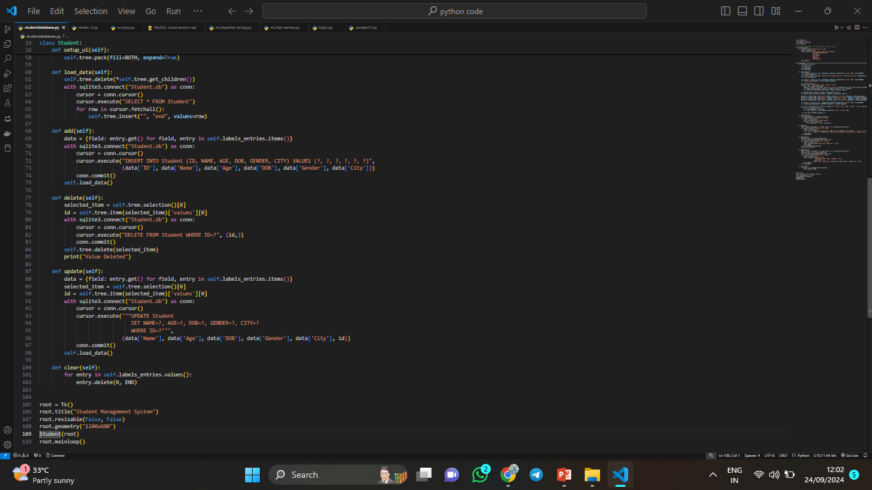
Student DB Management System Code

Slide 8
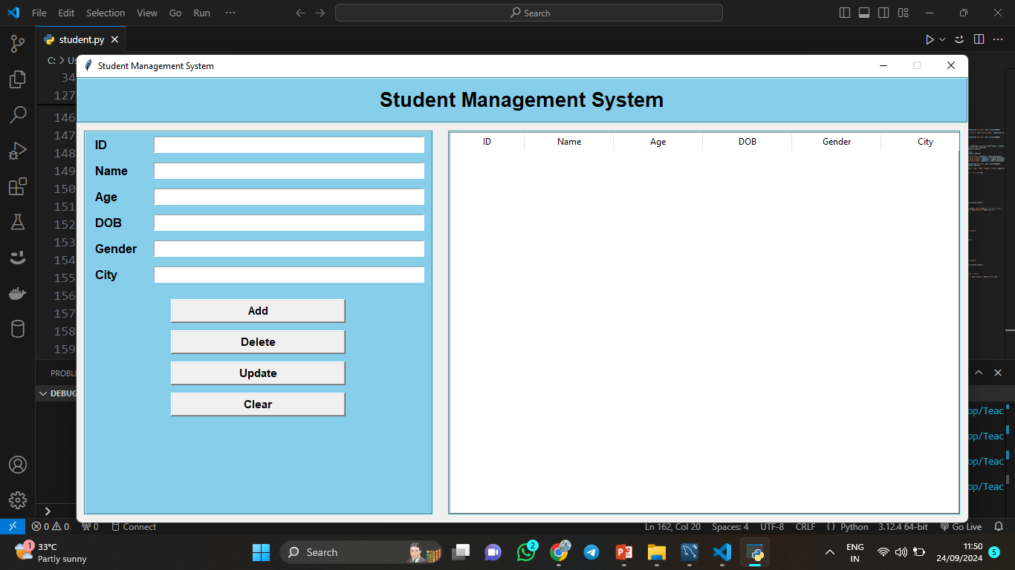
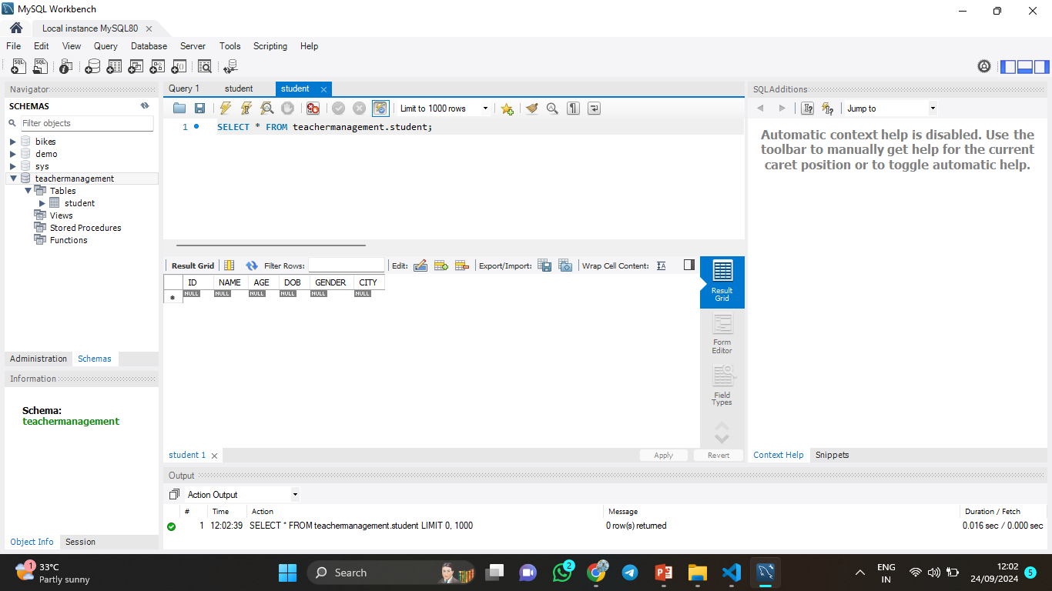
Student DB Management System Output

Slide 9
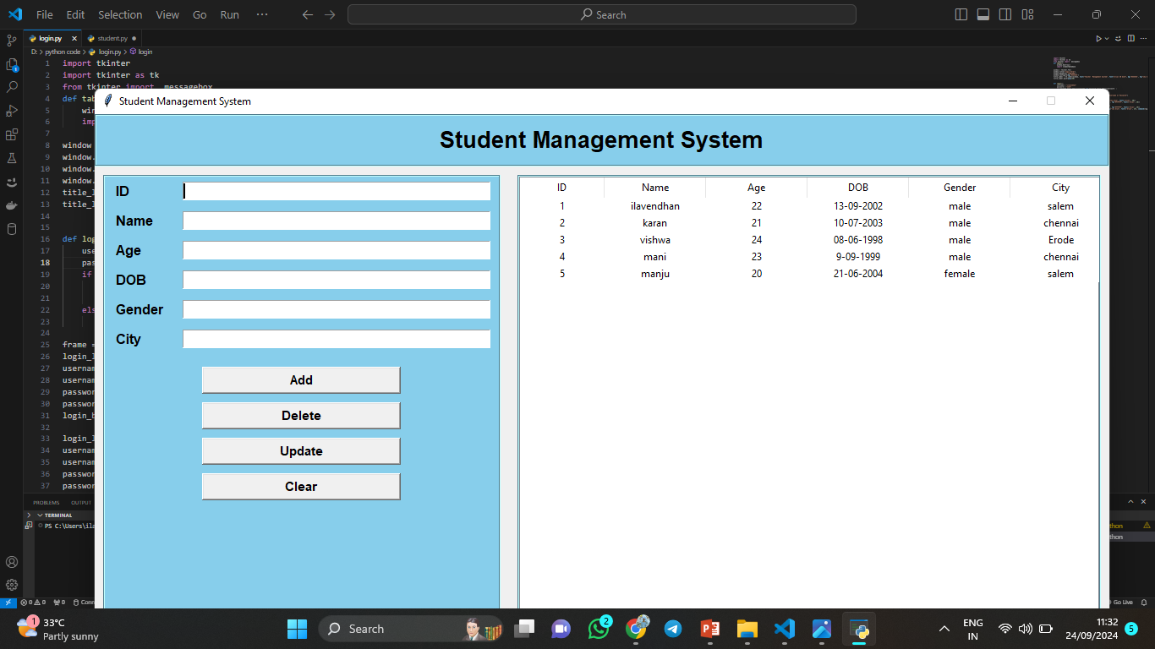
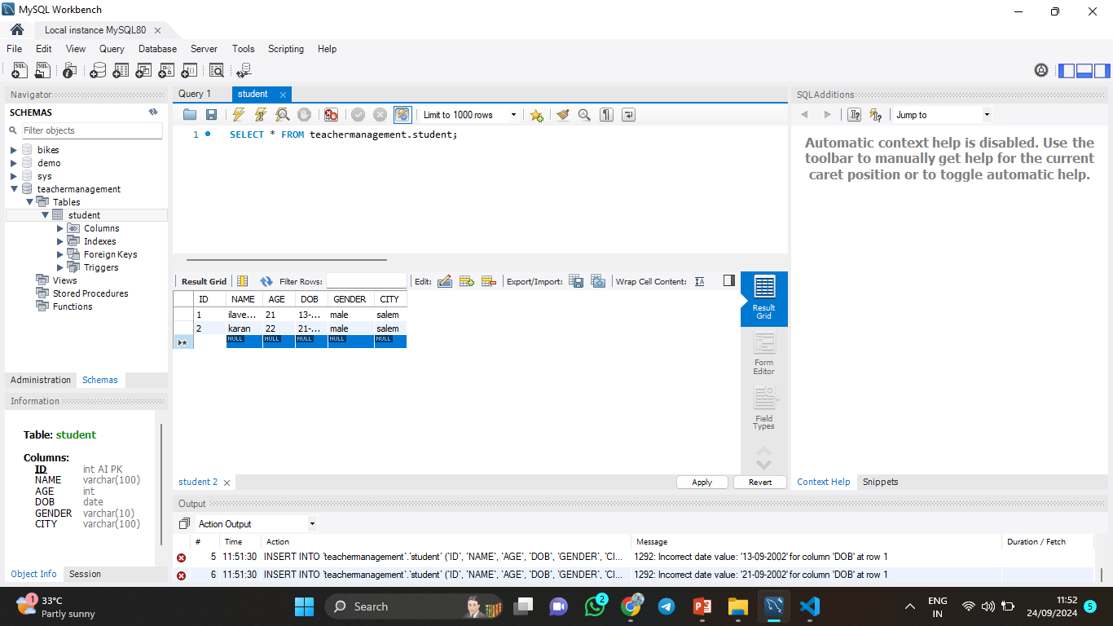
MYSQL DB

Slide 10
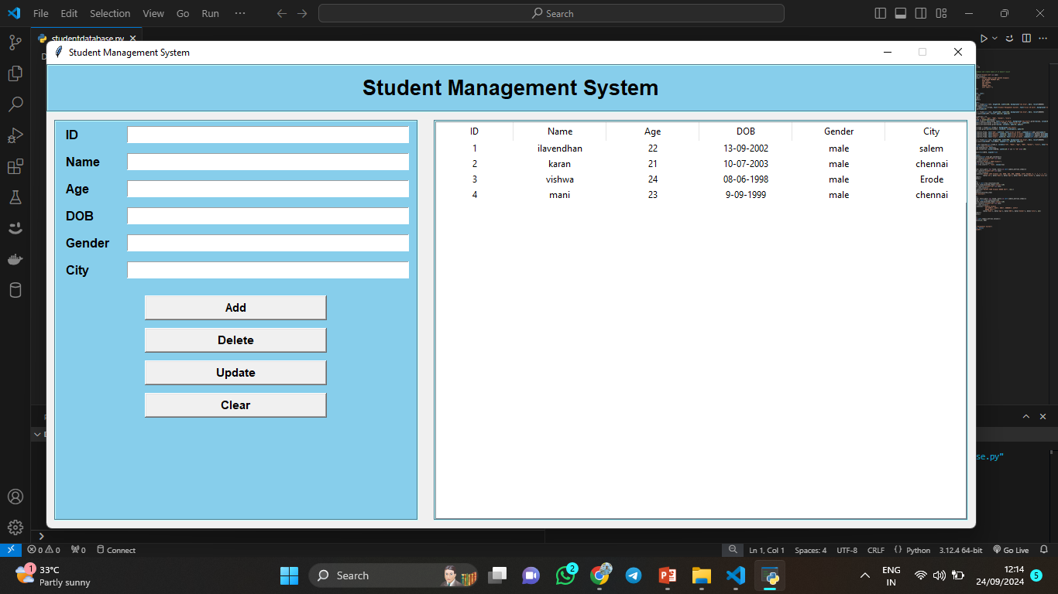
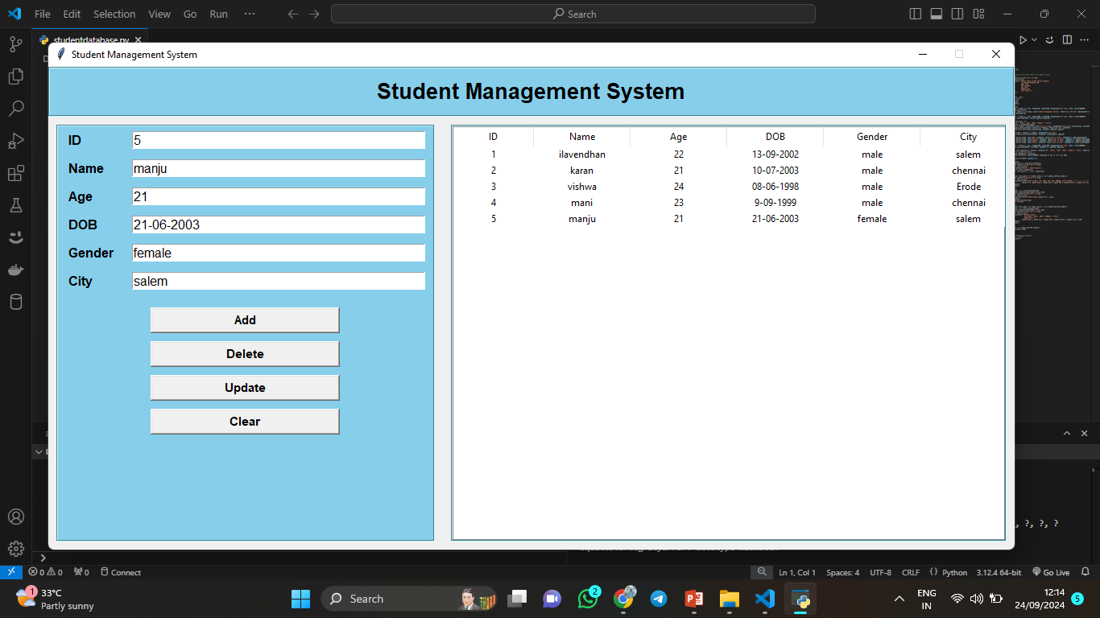
Add Student Data

Slide 11
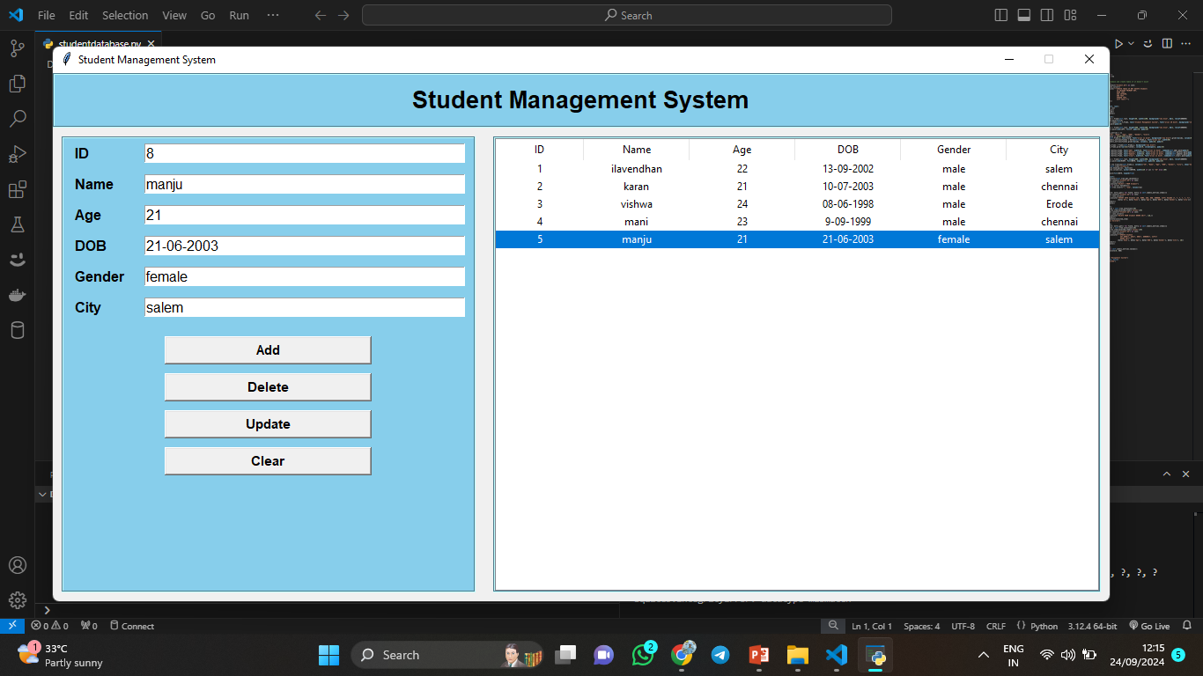

Update Student Data

Slide 12
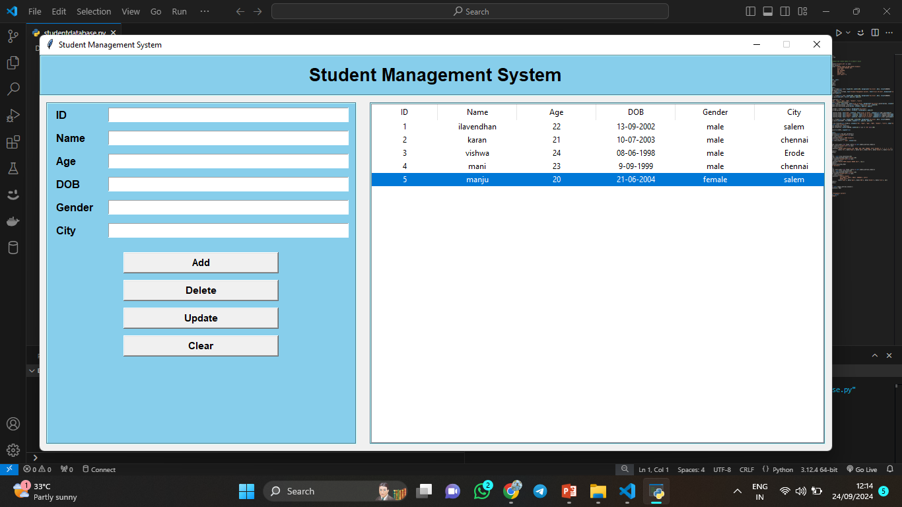
Delete Student Data

Slide 13

Clear Student Data

Slide 14
Thank you

